Slide 1
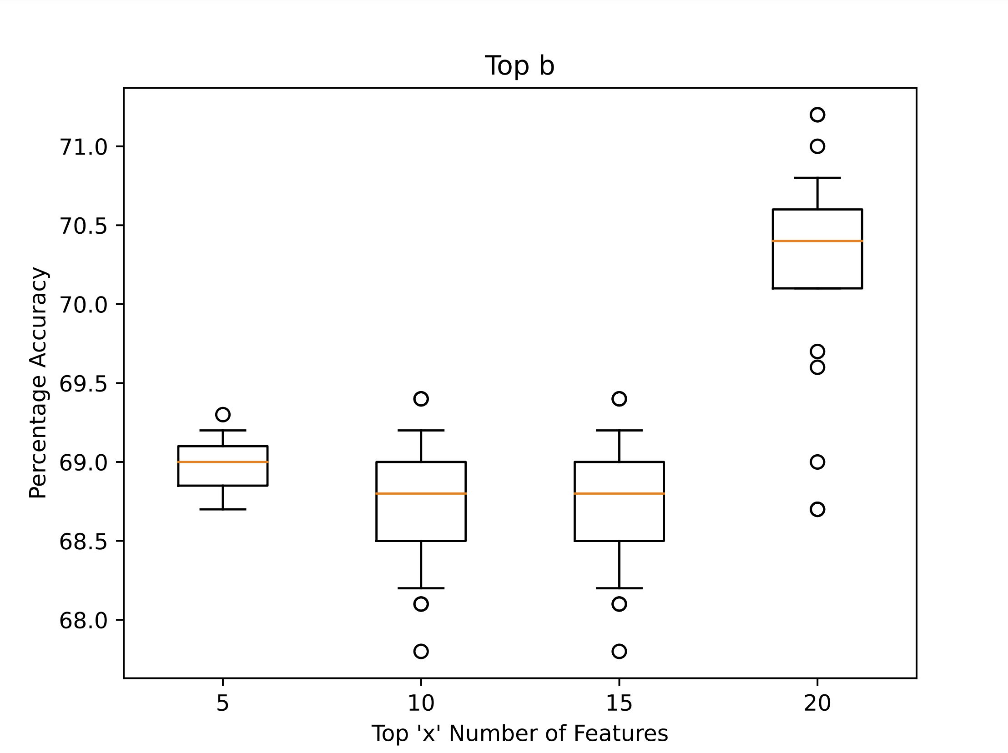
Accuracy for top 20 features Top b

Slide 2
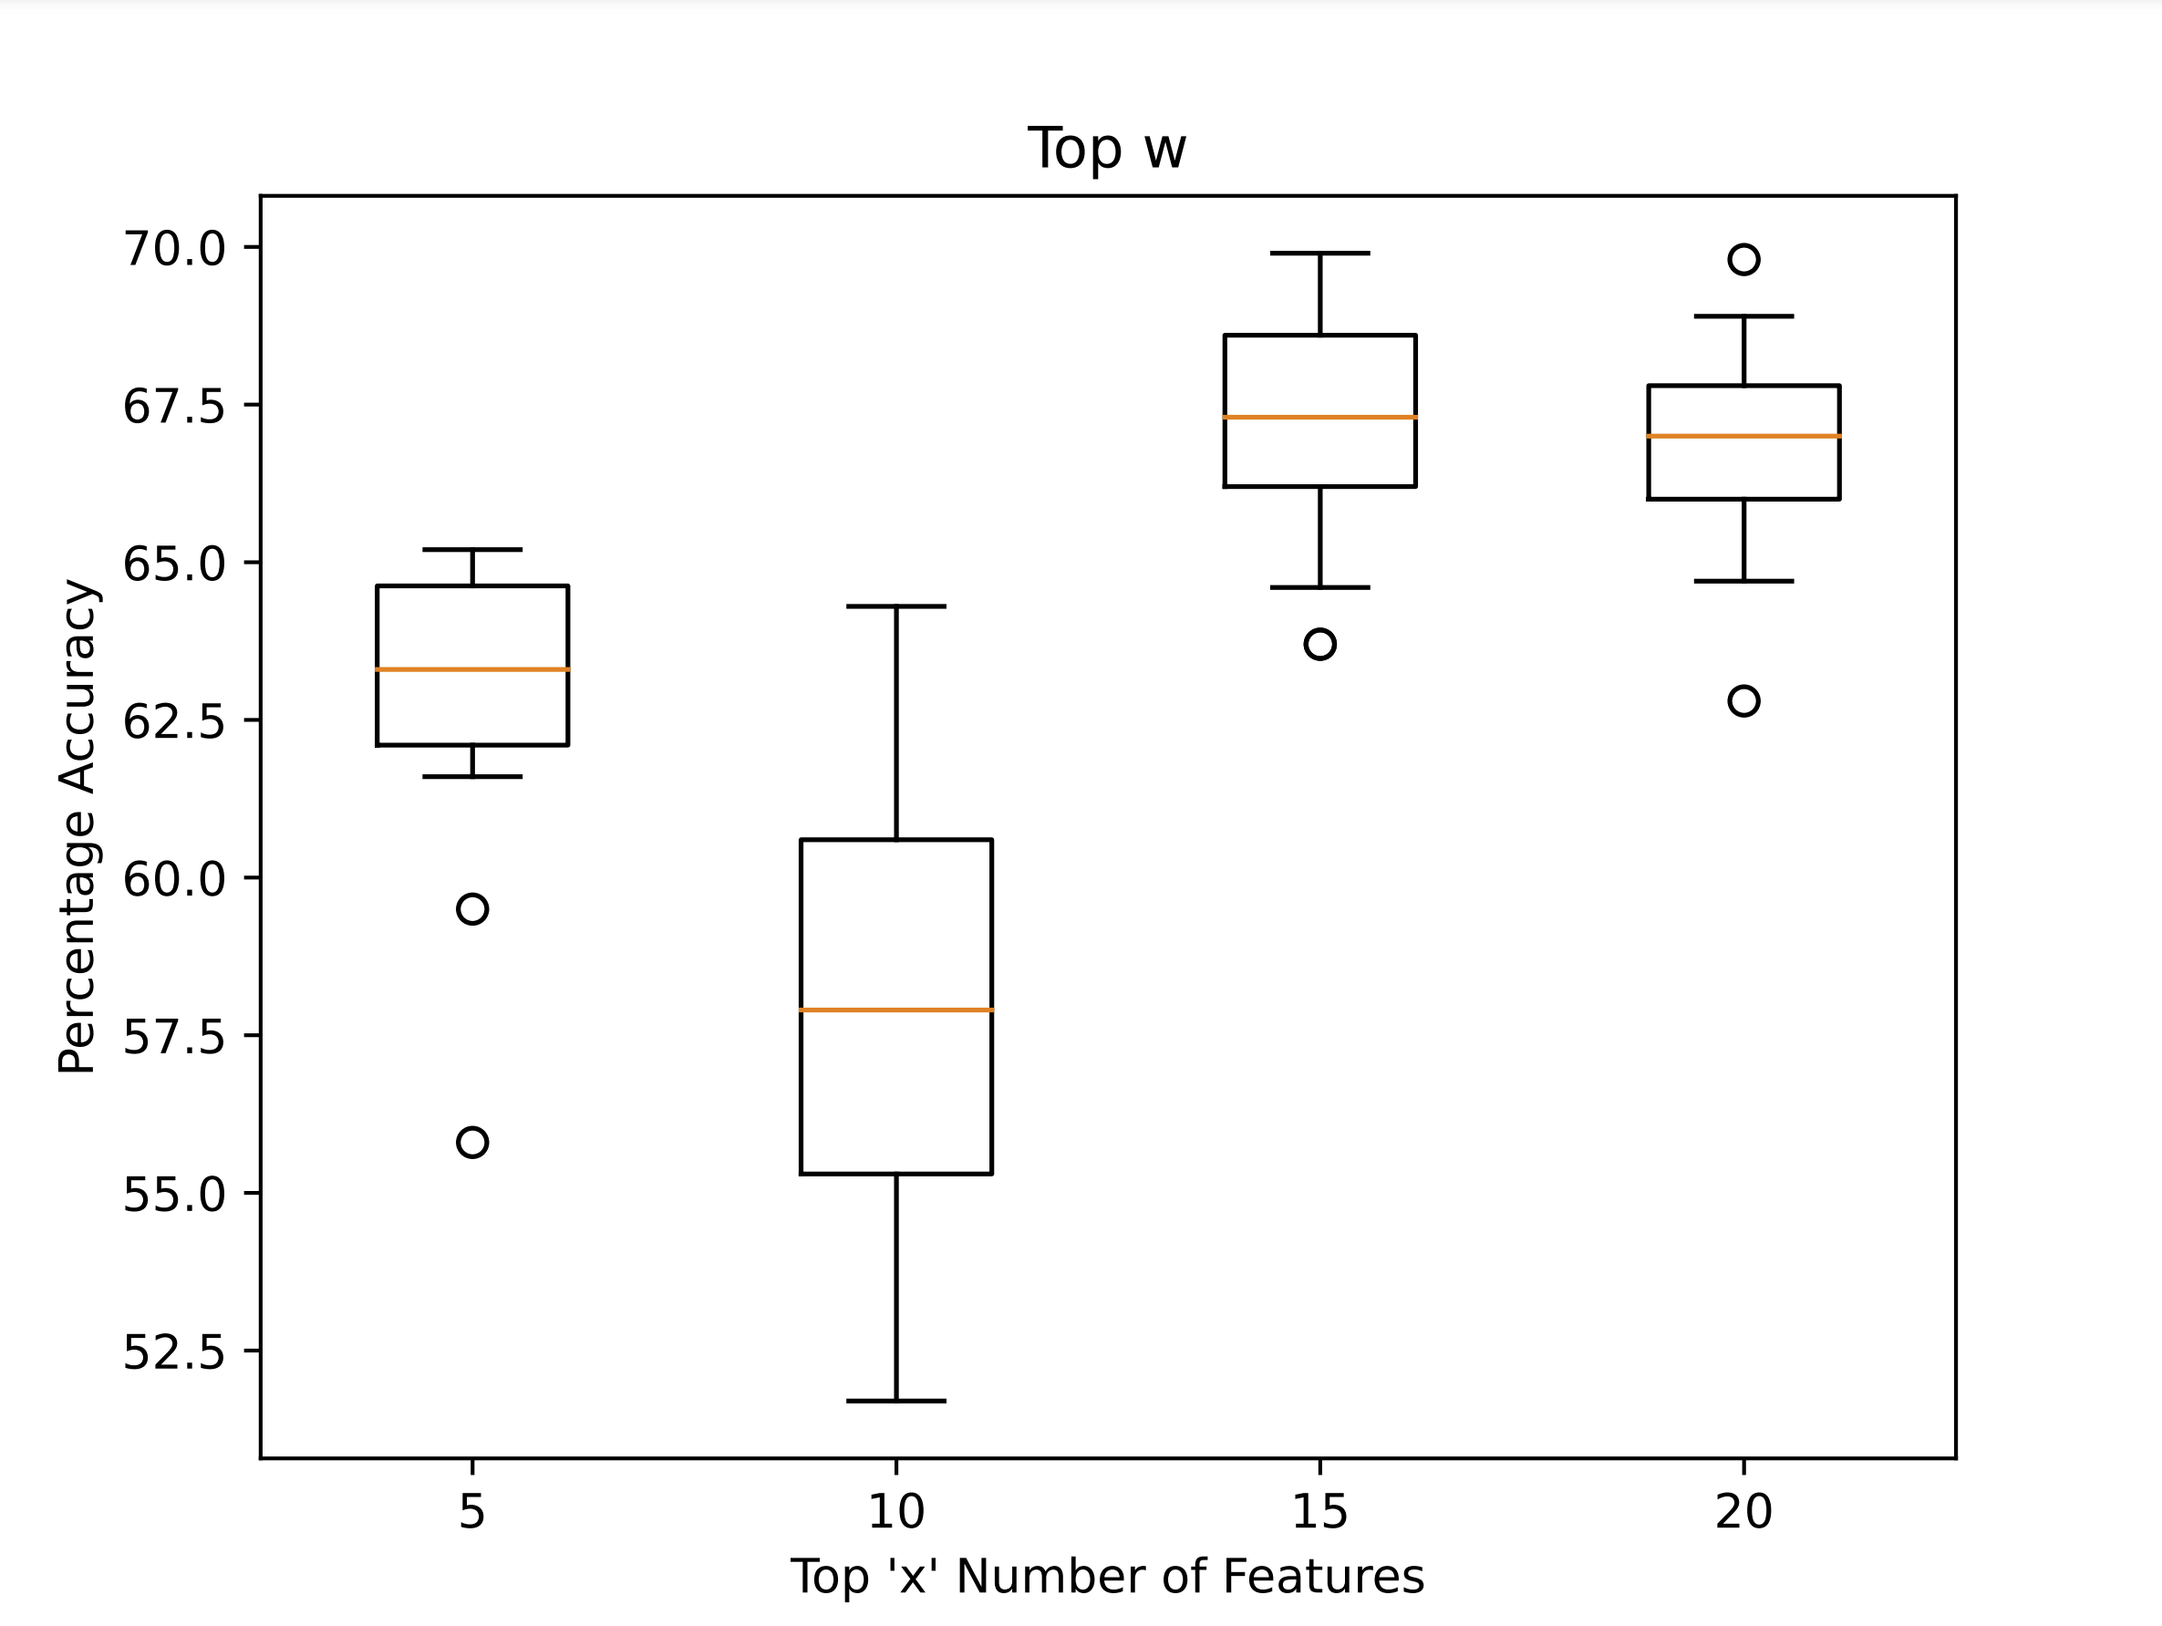
Accuracy for top 20 features Top w

Slide 3
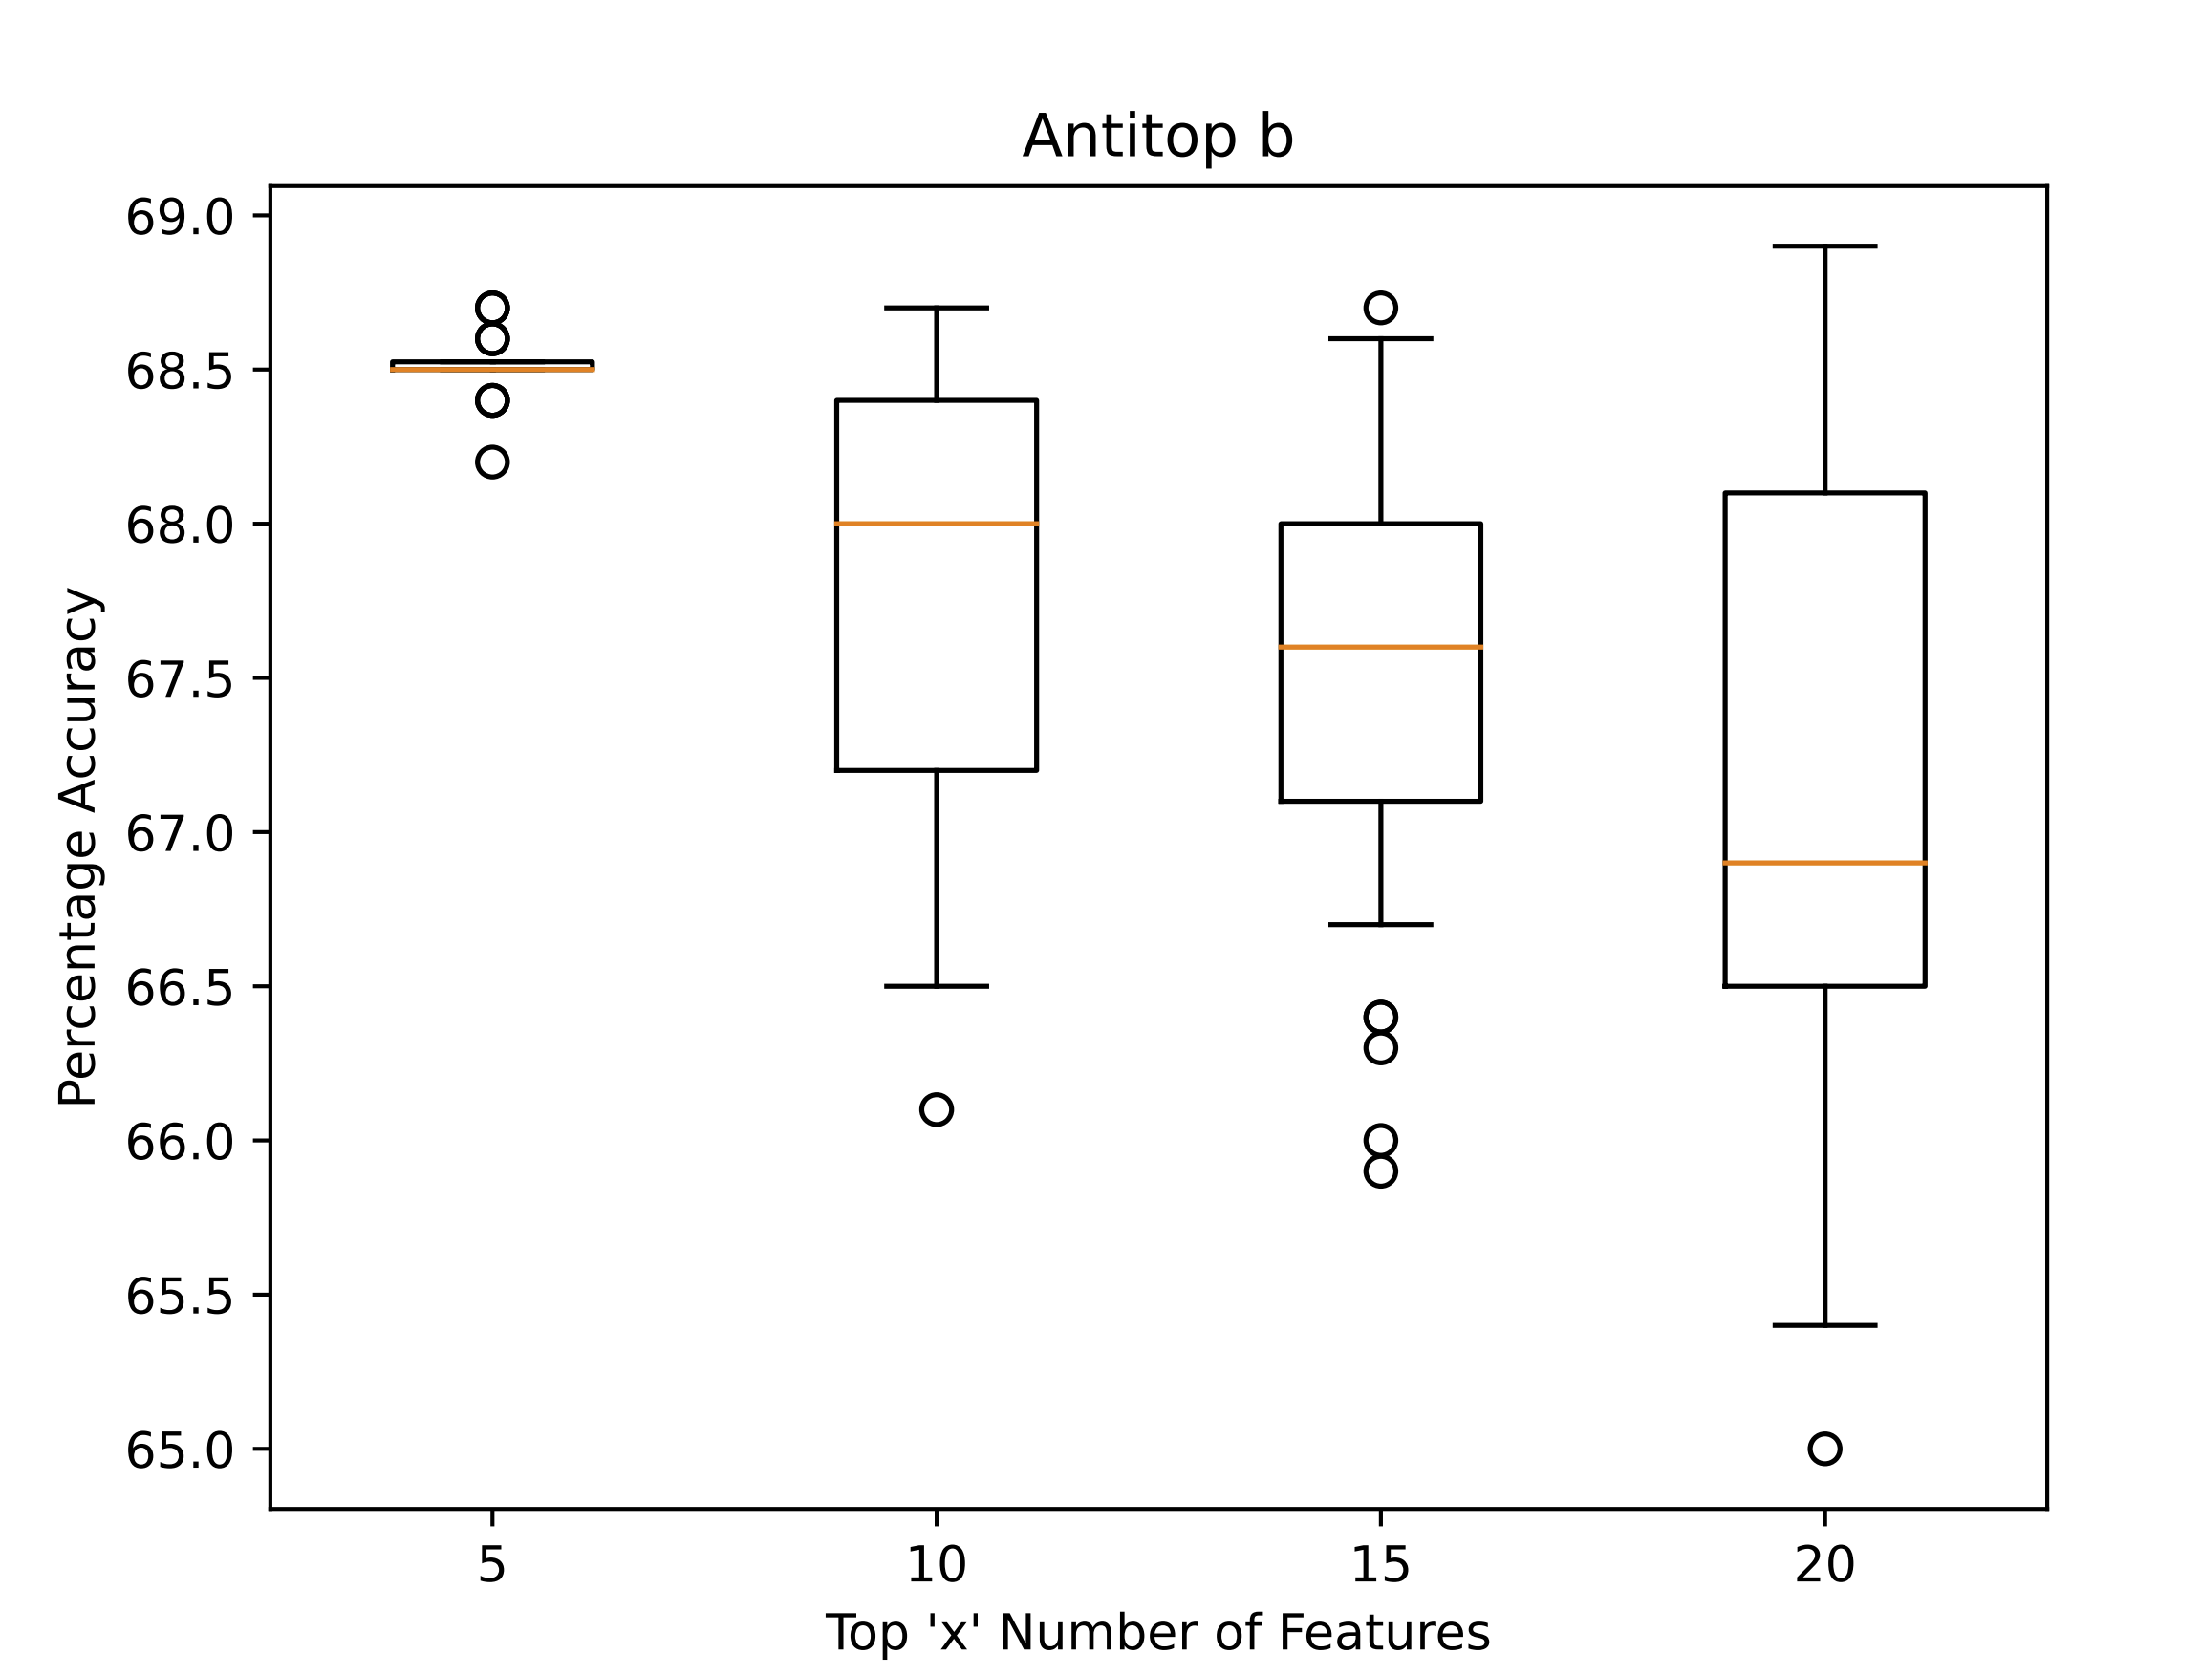
Accuracy for top 20 features Antitop b

Slide 4
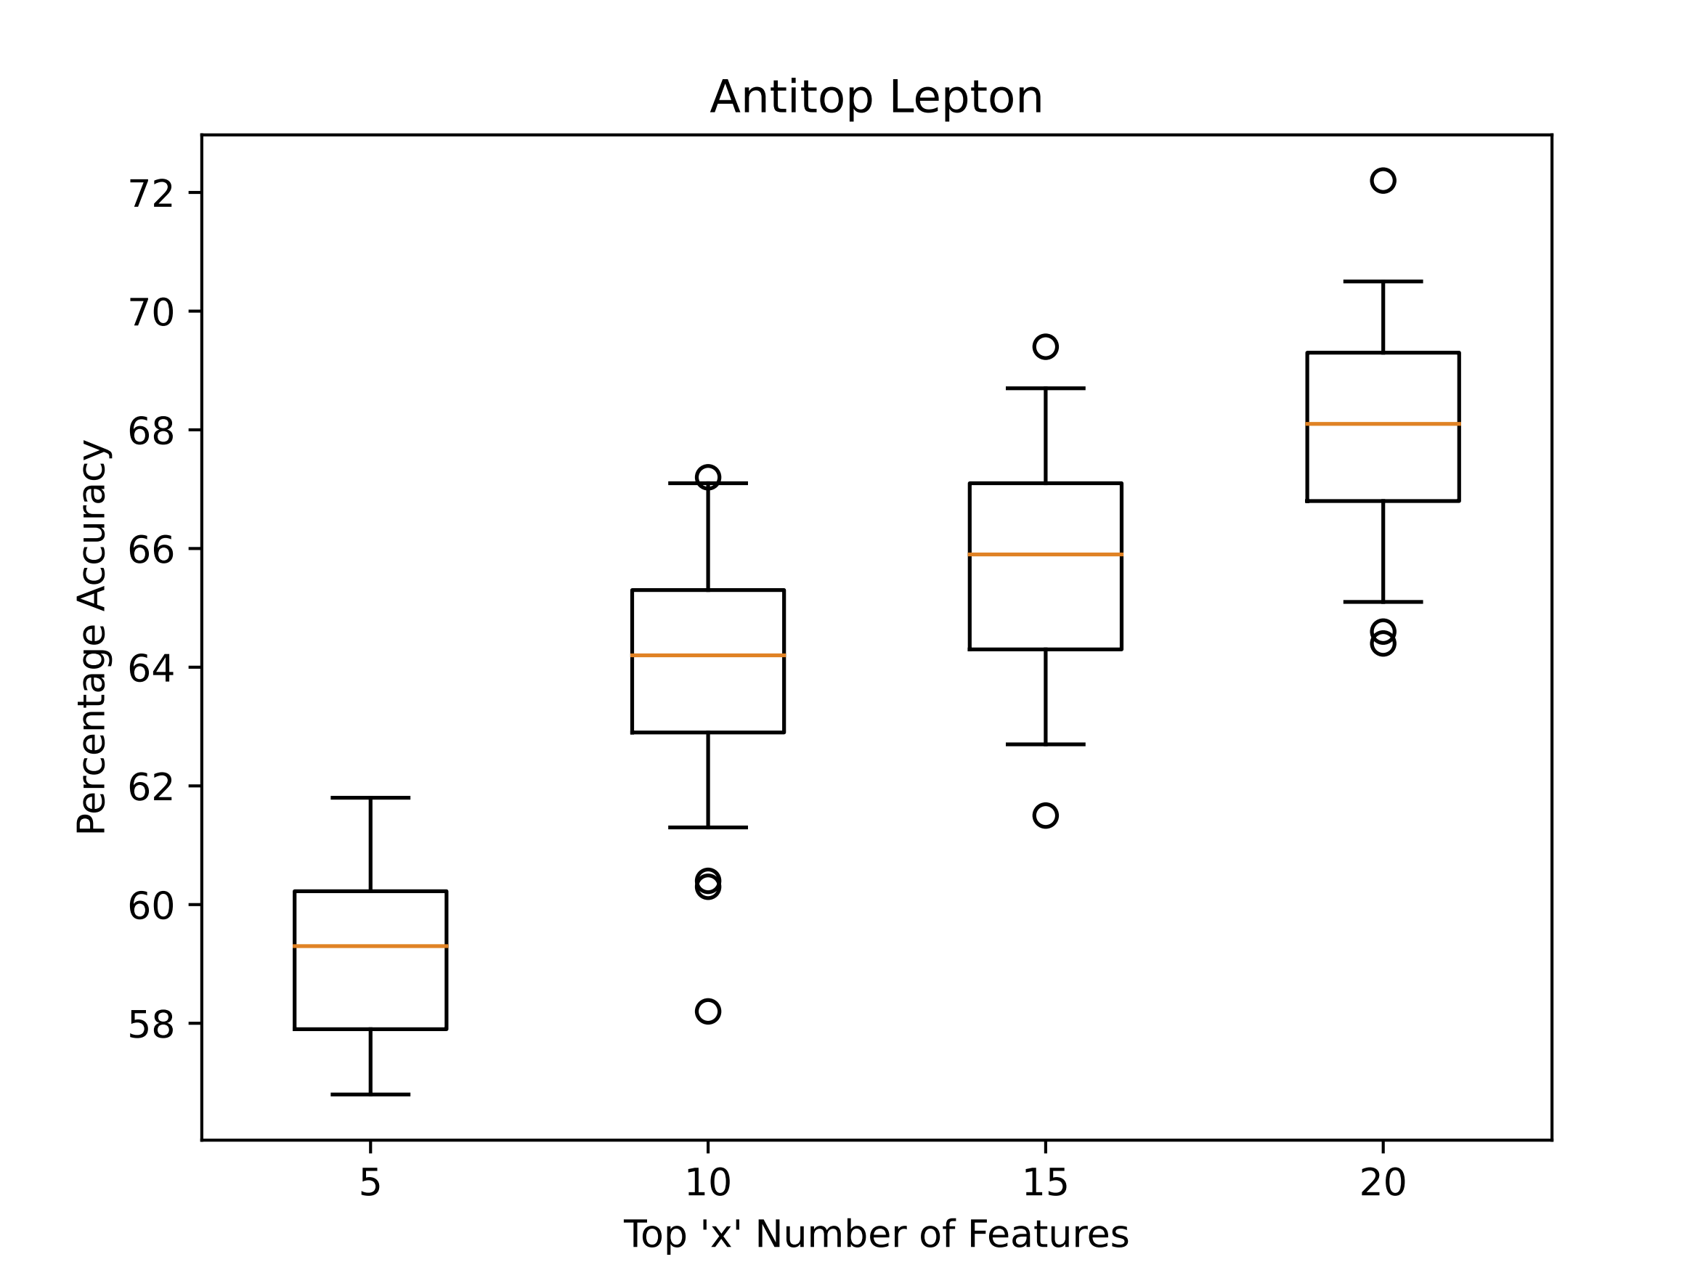
Accuracy for top 20 features Antitop Lepton

Slide 5
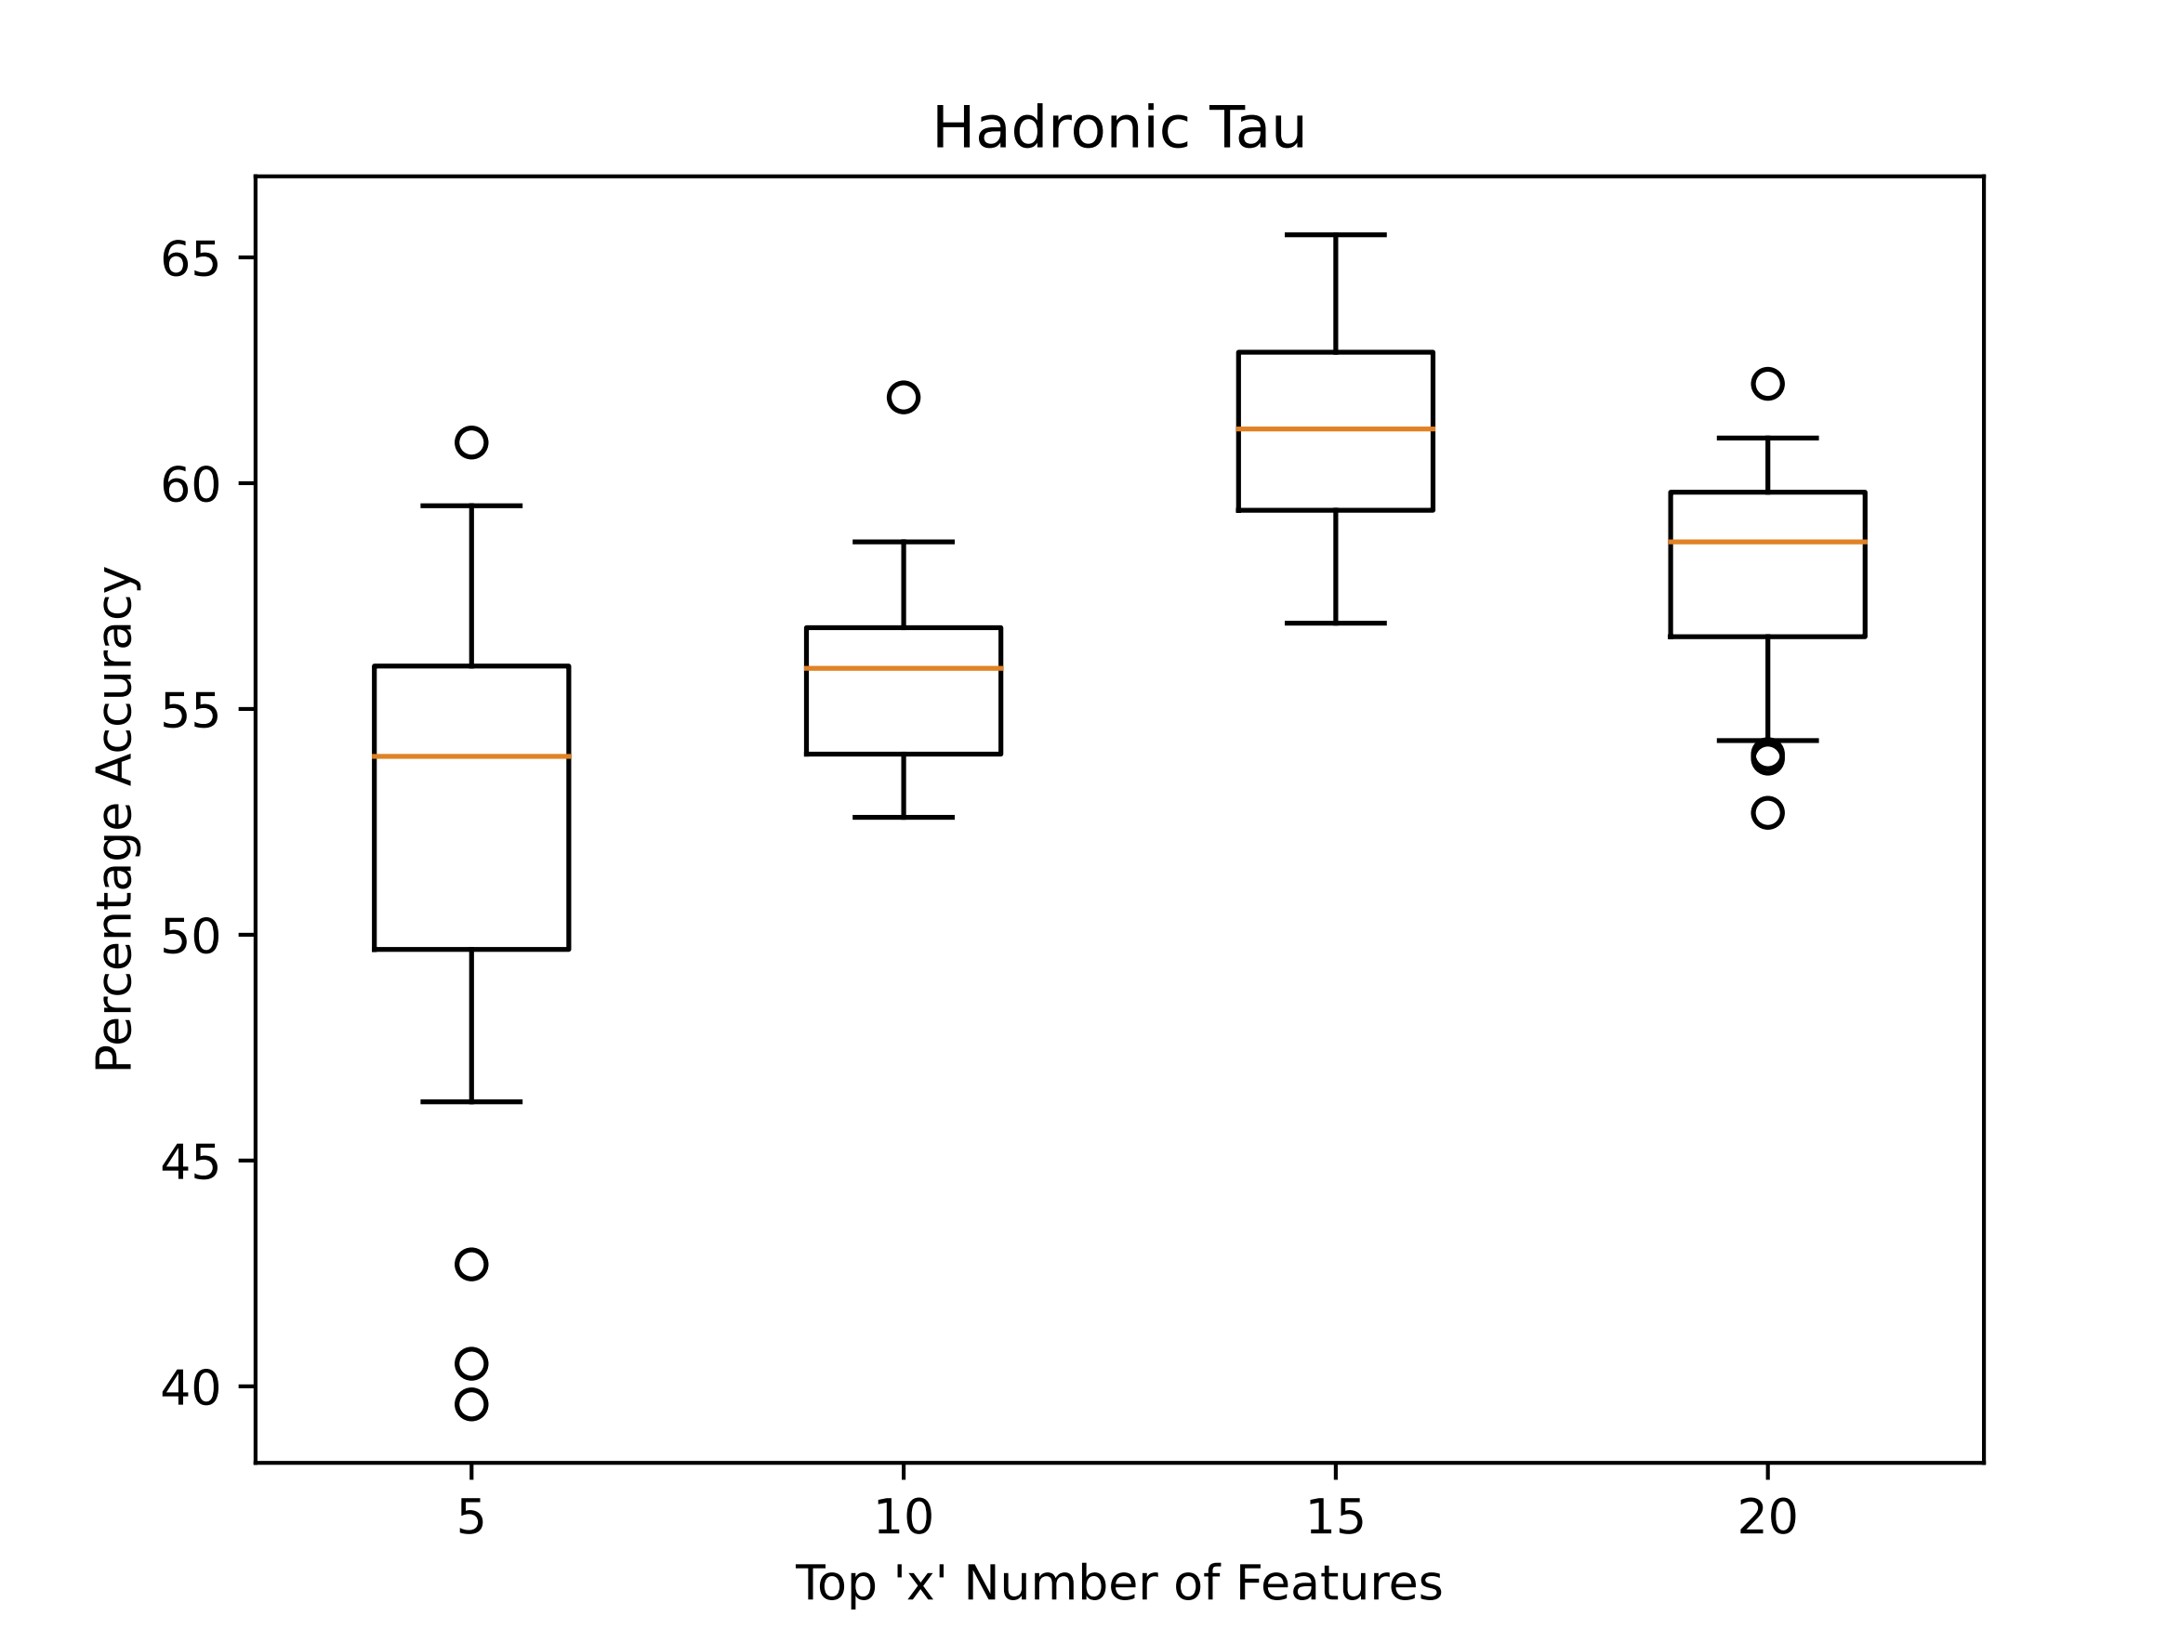
Accuracy for top 20 features Hadronic Tau

